Slide 1
Predicting Song Popularity and Enhancing Spotify's Recommender Systems: A Business Data Analytics Approach
Team Members,
1. Anjelina Sajan 2. Kirthan Shekhar 3. Lakshmy Prakash 4. Saya Santhosh

Slide 2

PROJECT OVERVIEW
Business Context: Spotify needs to predict song popularity to enhance recommendations. Dataset spans 1998-2020 U.S. Spotify charts Goal: Improve user engagement through better song predictions
Key Objectives: 1. Develop three predictive models for song popularity
2. Optimize model selection based on financial metrics
3. Analyze feature patterns for improved recommendations
Dataset Scope:
27 features including audio characteristics 1500+ songs across multiple genres Popularity scores as target variable
Methodology: Data preprocessing and feature engineering Model development and comparison Profit-based optimization Clustering analysis for insight generation

Slide 3
PROJECT PHASES
Phase 1: Predict Song Popularity (Q1)
Develop and evaluate predictive models.
Identify the best-performing model for predicting popularity.
Phase 2: Profit Maximization (Q2)
Incorporate cost-benefit analysis into model selection.
Optimize predictions to maximize revenue and minimize errors.
Phase 3: Feature Insights and Clustering (Q3)
Analyze the role of song characteristics (e.g., valence) in predicting success.
Cluster songs by danceability and energy to identify patterns.

Slide 4
Phase 1: Predict Song Popularity (Q1)
The problem is that Spotify wants to improve its song recommendation system by predicting which new songs are likely to become popular. Specifically, they want to predict whether a song's popularity score will exceed 50 based on various song characteristics like danceability, energy, tempo, etc.
The goal is to develop and compare three different predictive models, using provided historical data from 1998-2020, and select the best model based on accuracy metrics to help Spotify prioritize songs that are more likely to engage users effectively.
"Key features like danceability, energy, tempo, and valence are analyzed to determine their relationship with popularity scores."

Slide 5
OBJECTIVES
Develop and compare three different predictive models to forecast whether a song's popularity score will exceed 50, using appropriate data preprocessing and feature selection techniques.
Create an appropriate data preprocessing pipeline including handling missing values, encoding categorical variables, and selecting relevant features for prediction.
Identify the best performing model based on accuracy metrics and justify why it's the most suitable choice for predicting song popularity.
Provide actionable managerial insights for Spotify about which song attributes are associated with higher engagement and popularity, to help them optimize playlists and song recommendations.

Slide 6
MODEL DEVELOPMENT AND EVALUATION
Logistic Regression: Include confusion matrix results, precision, recall, and F1 score.
Decision Tree: Highlight its overfitting tendencies.
KNN: Emphasize its balance and consistent metrics.

Slide 7
LOGISTIC REGRESSION
Overview: Binary classification model predicting song popularity (>50 = Popular)
Key Components: - Features: Danceability, energy, valence Target: Binary popularity (1/0) Threshold: 50 popularity score
Model Performance: Accuracy: 83.47% Consistency: High stability across validation Implementation: Feature-weighted probability calculation
Application to Spotify: Input → Process → Output Song features → Probability calculation → Popularity

Slide 8
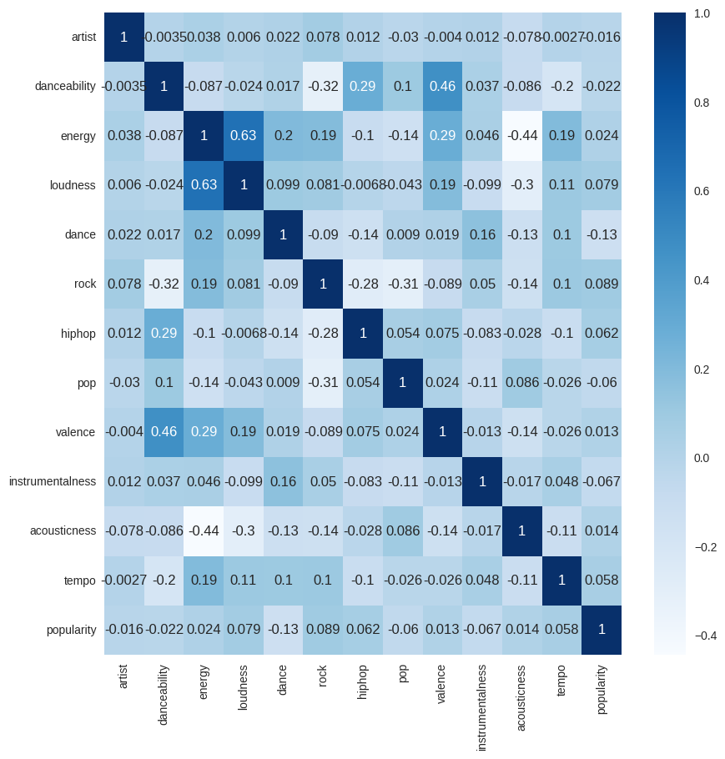
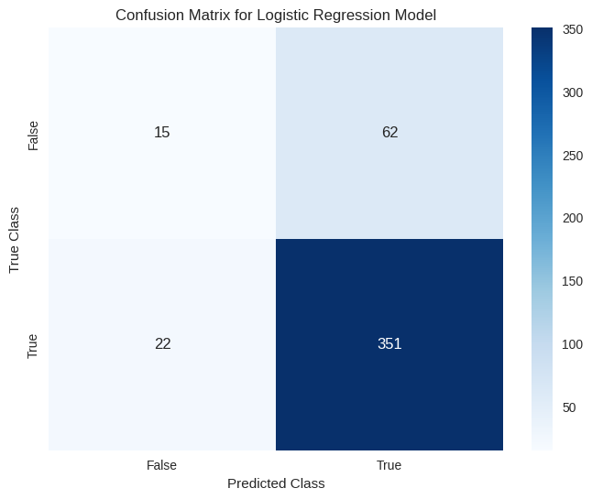
LOGISTIC REGRESSION: FEATURE CORRELATIONS

Slide 9
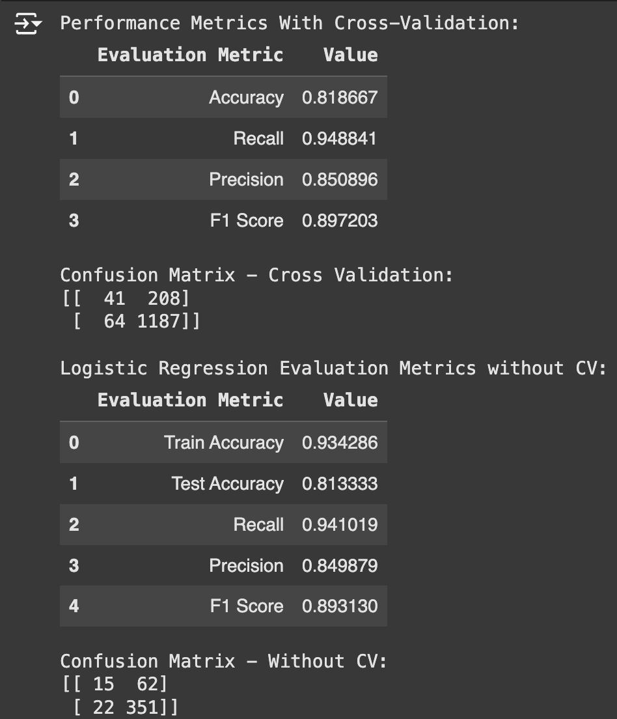
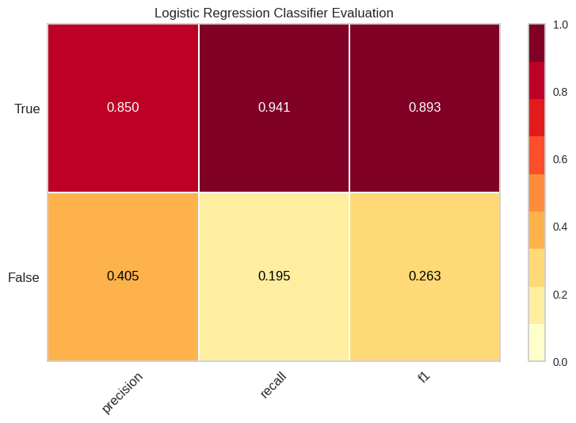
LOGISTIC REGRESSION: MODEL EVALUATION
Key Findings: - Strong performance on popular songs (94.1% recall) - Balanced accuracy of 81.9% - Consistent cross-validation results - Slight overfitting mitigated by regularization

Slide 10
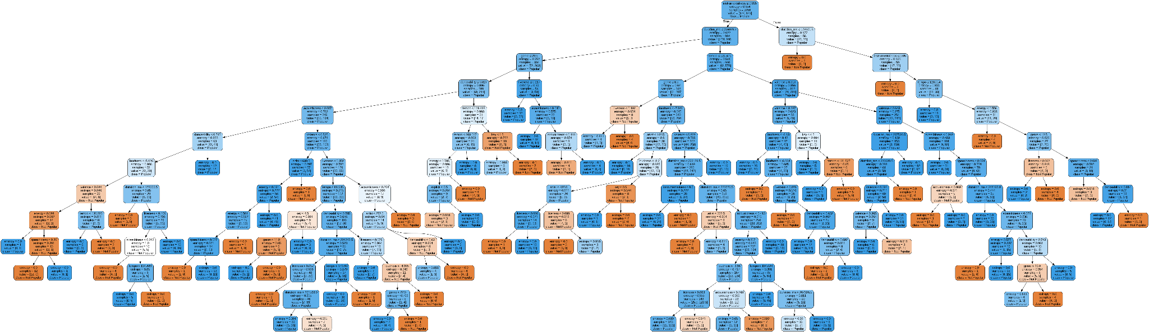
DECISION TREE: INITIAL MODEL STRUCTURE

Slide 11
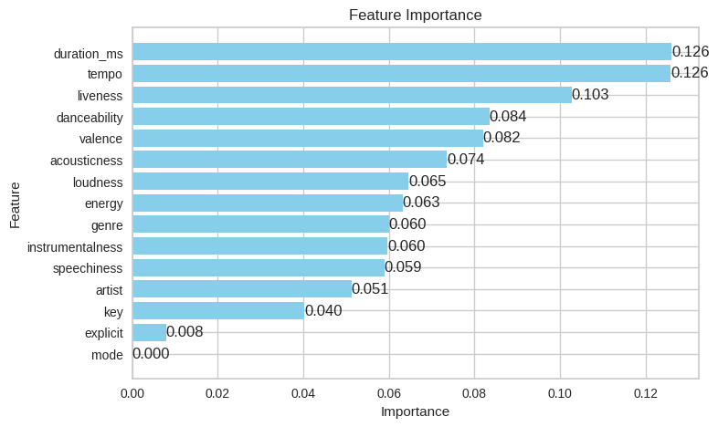
DECISION TREE: FEATURE IMPORTANCE ANALYSIS

Slide 12
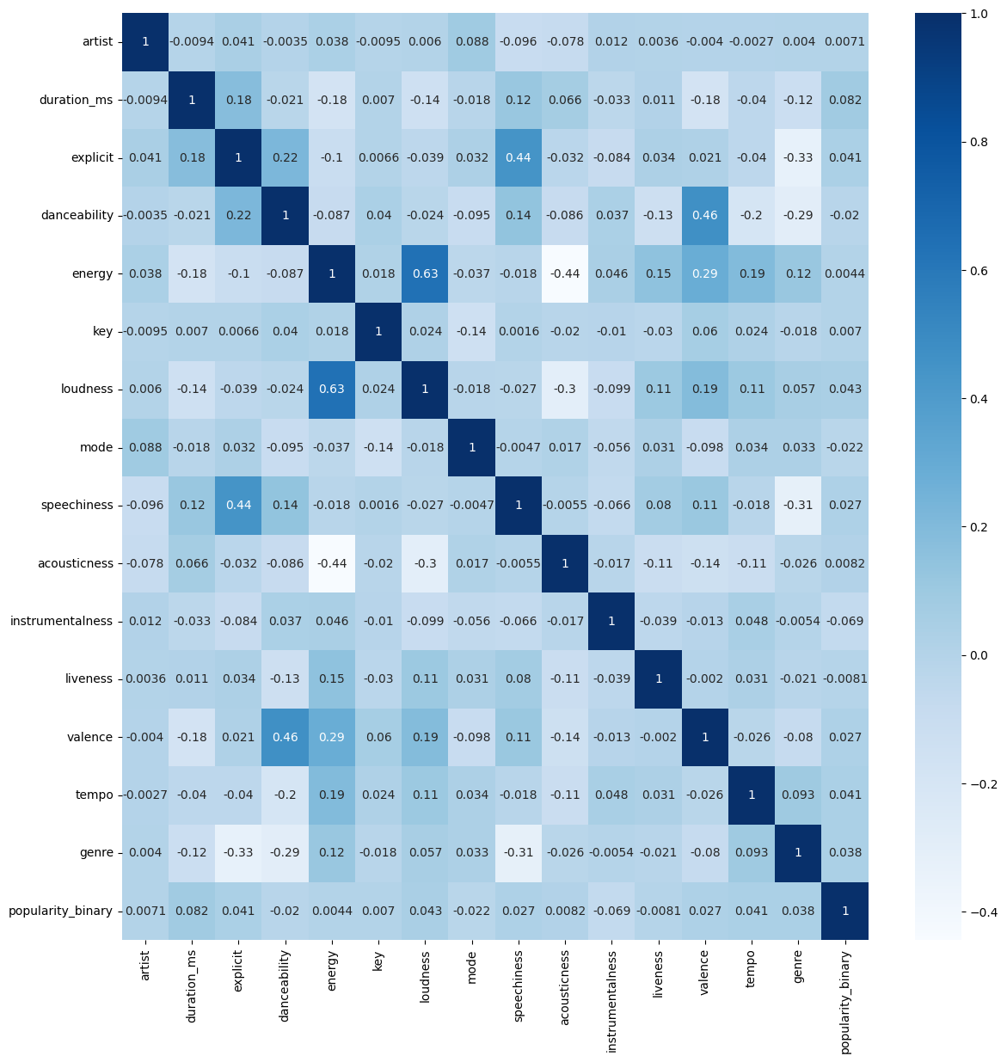
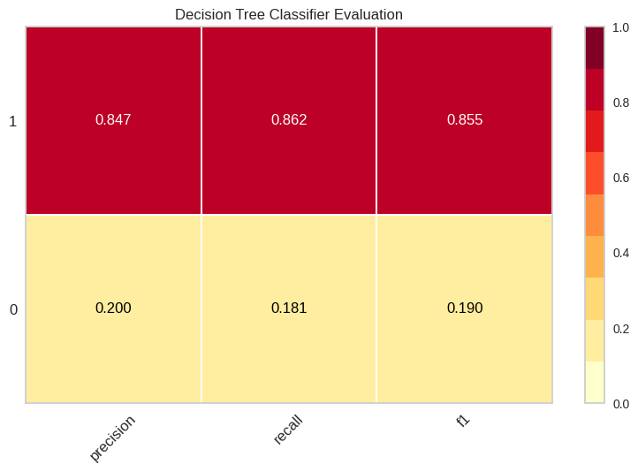
DECISION TREE: MODEL EVALUATION

Slide 13
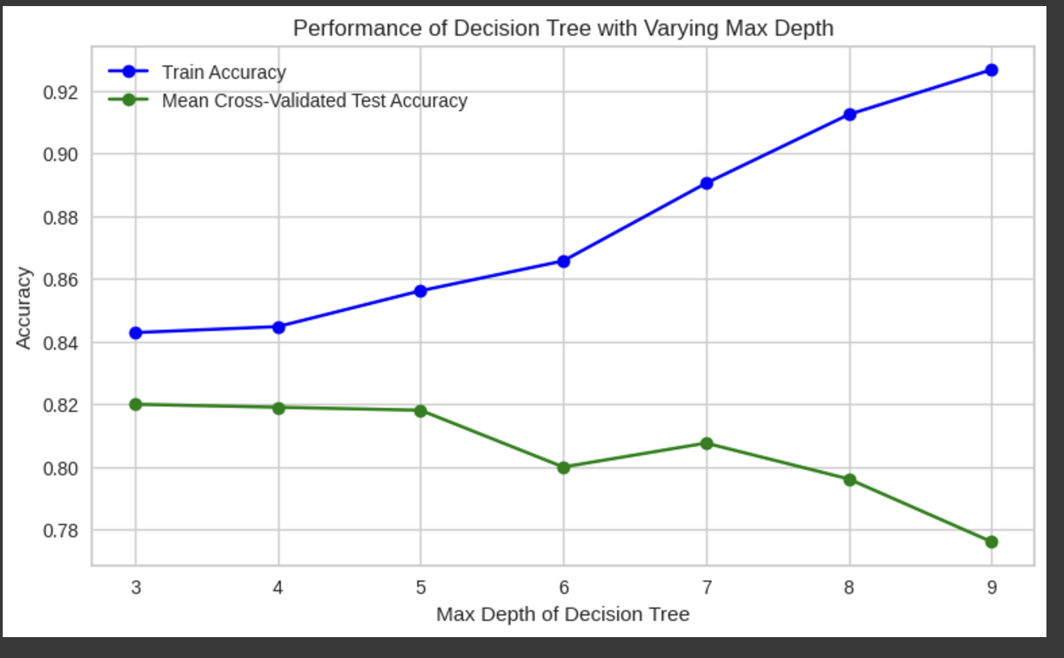
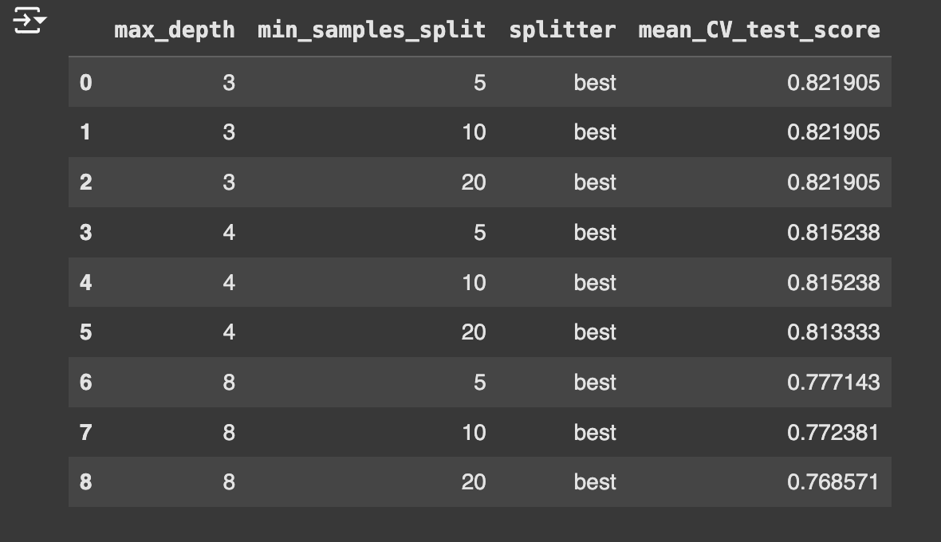
DECISION TREE: HYPERPARAMETER OPTIMIZATION

Slide 14
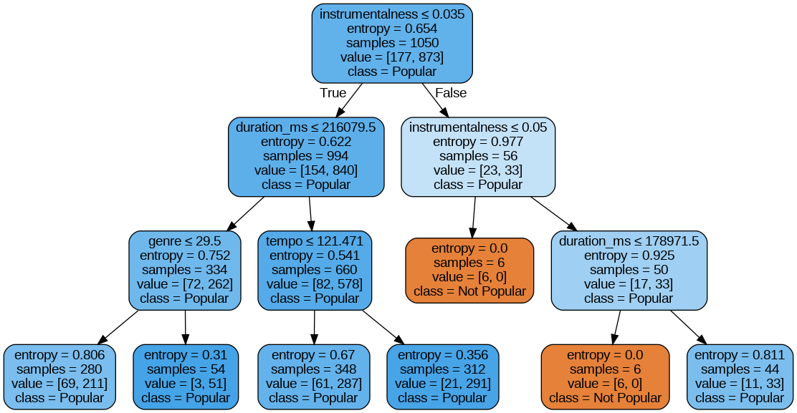
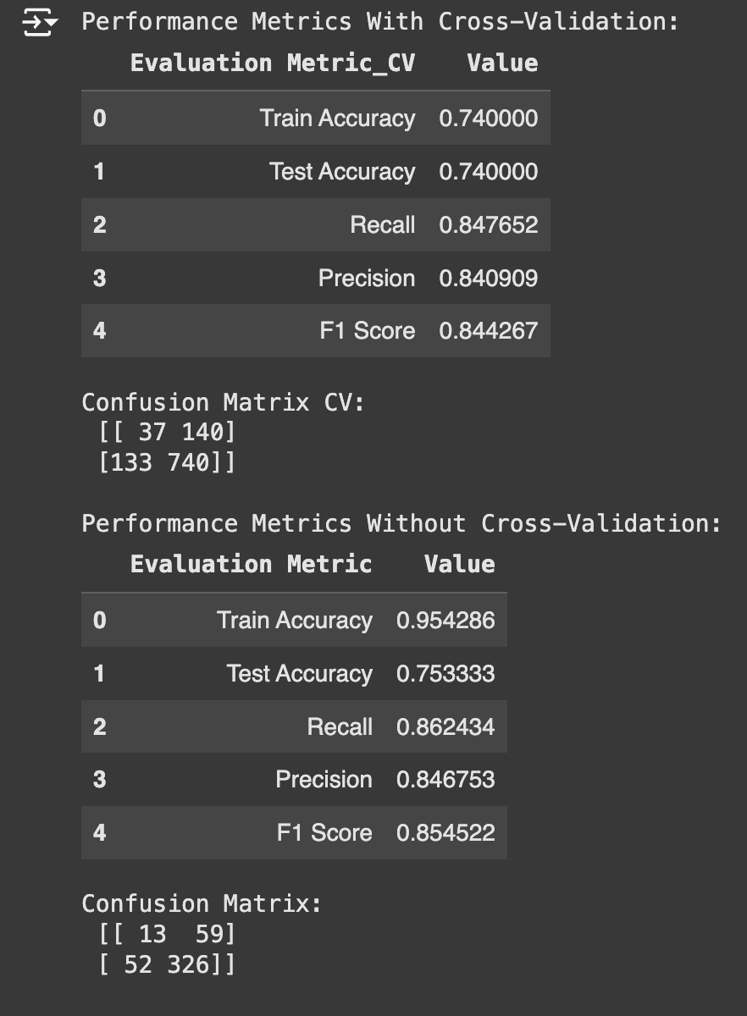
DECISION TREE: DETAILED ANALYSIS
This decision tree shows how songs are classified for popularity, starting with instrumental as the main factor where less instrumental songs (≤0.035) tend to be more popular, then considering factors like duration and genre for further decisions, and finally leading to predictions through a series of yes/no questions that result in either "Popular" or "Not Popular" classifications.

Slide 15
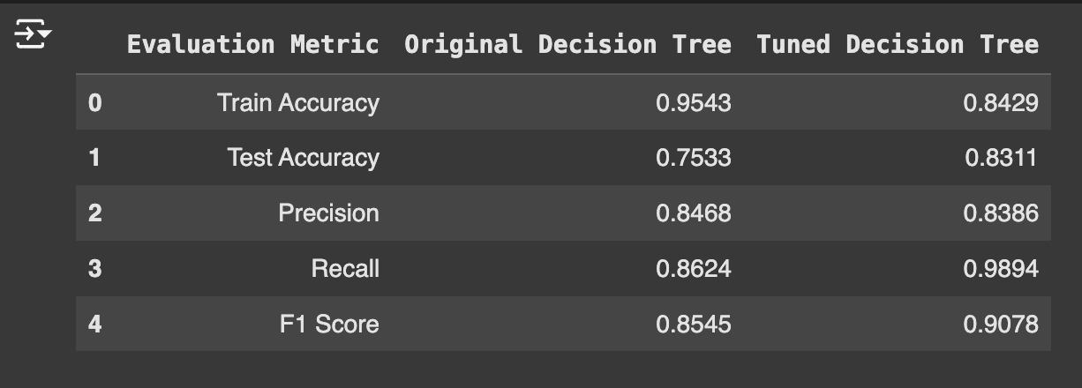
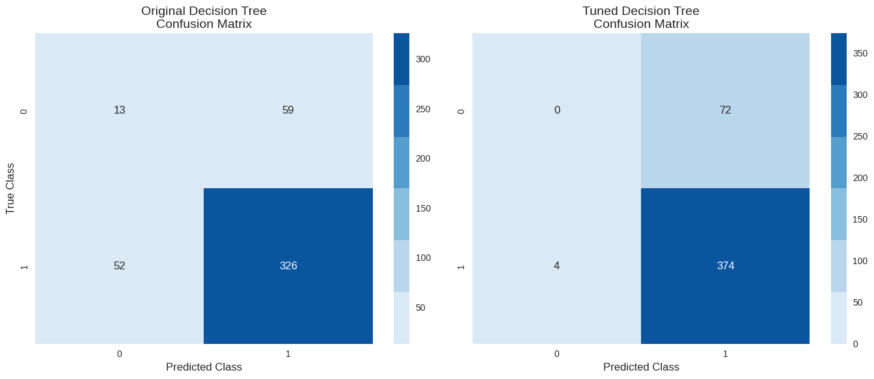
DECISION TREE: TUNING IMPACT ANALYSIS
Key Findings: - Reduced overfitting gap (20% → 1%) - Improved popular song detection - Trade-off: Lost unpopular song identification ability - Better overall stability in predictions

Slide 16
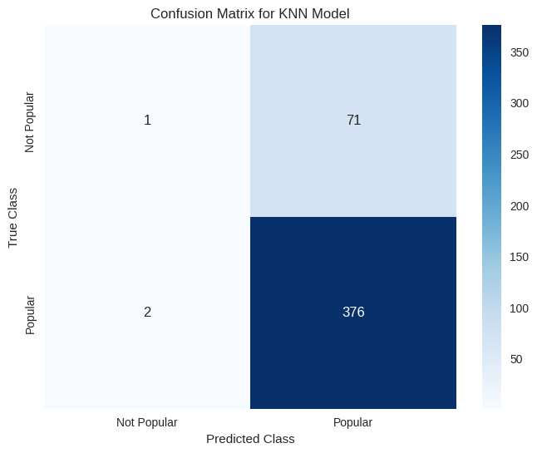
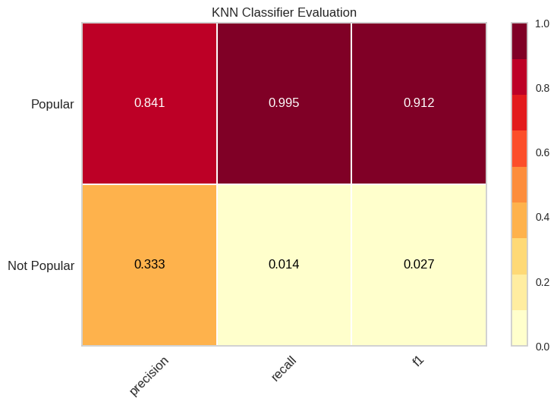
KNN MODEL: INITIAL PERFORMANCE
Key Performance Metrics:
- Strong popular song detection: 376/378 correct (99.5% recall)
- Precision on popular songs: 84.1%
- Challenge: 71 false positives for unpopular songs
- Optimal for Spotify's goal of maximizing engagement

Slide 17
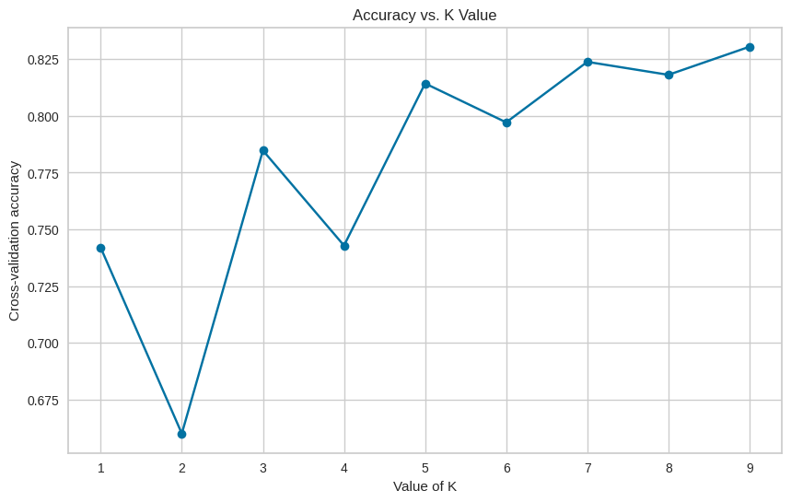
KNN MODEL: K-VALUE OPTIMIZATION
Choose K=7 or 9 for your model as it:
Provides highest accuracy
Shows stability (not too sensitive to small changes)
Avoids overfitting (which might happen with K=1)

Slide 18
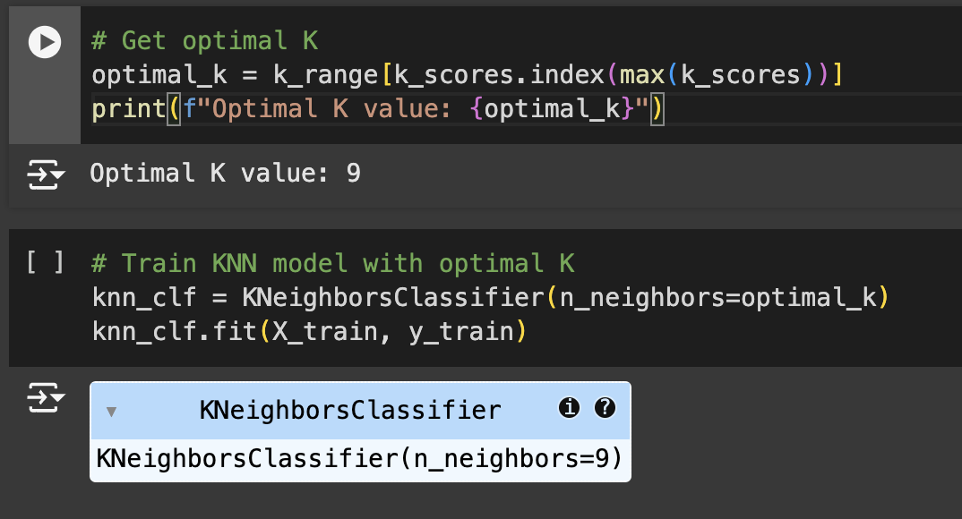
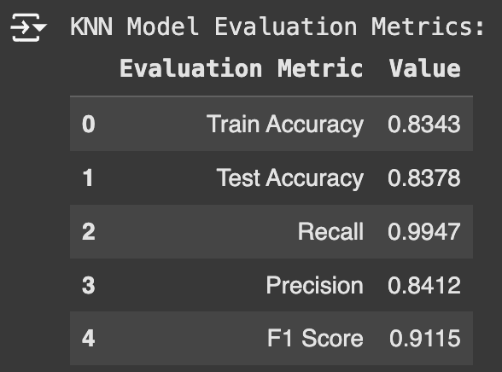
KNN MODEL: OPTIMAL CONFIGURATION
Final Model Configuration:
- K=9 (optimal value)
- Training Accuracy: 83.43%
- Test Accuracy: 83.78%
- F1 Score: 0.9115

Slide 19
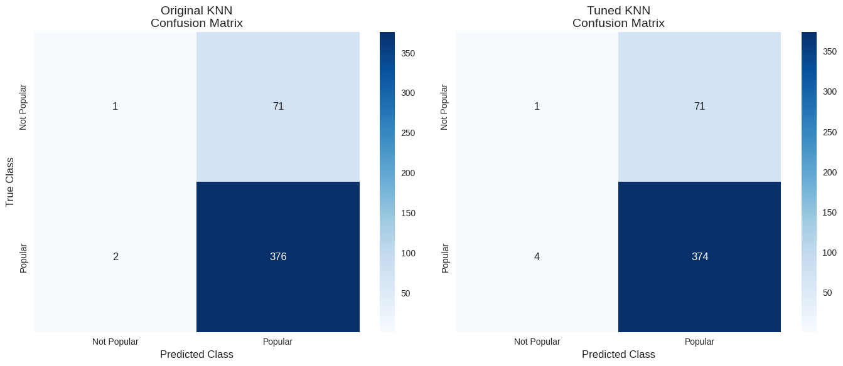
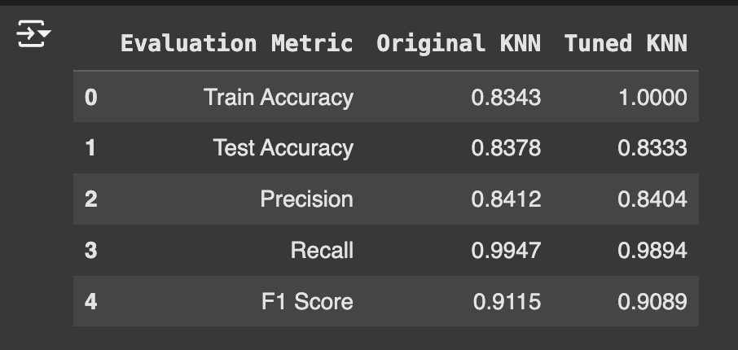
KNN MODEL: TUNING COMPARISON
Tuning Impact:
- Original vs Tuned: Similar test accuracy (~83%)
- Both models excel at popular song detection (>98% recall)
- Tuned model shows potential overfitting (100% train accuracy)
- Original model preferred for deployment

Slide 20
MODEL COMPARISON

Slide 21
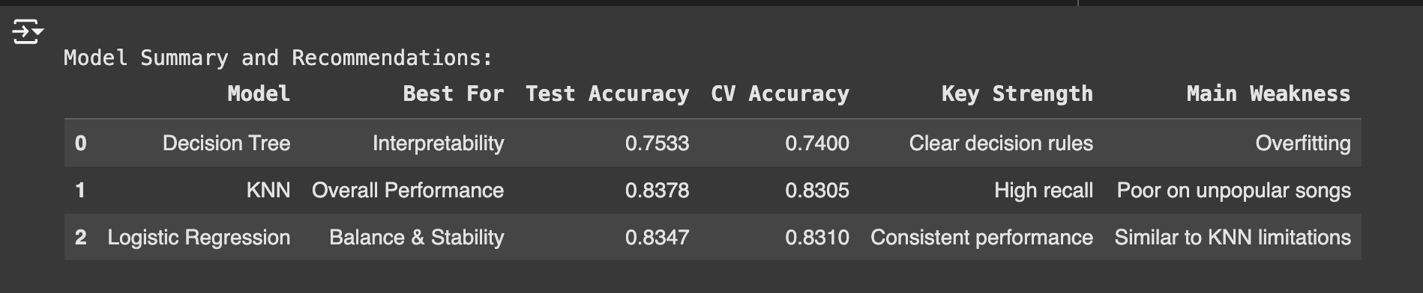
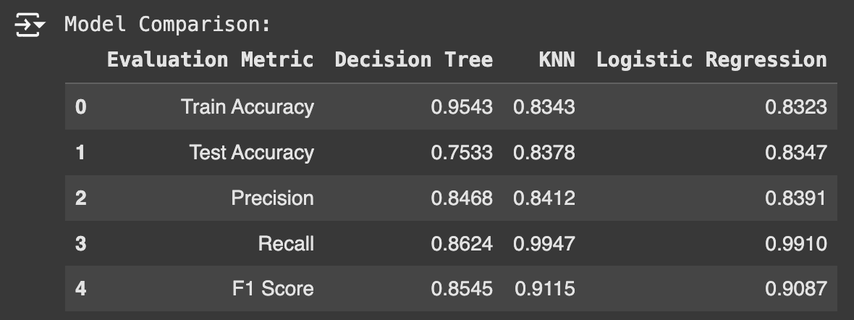
Model Comparison for Spotify Song Popularity Prediction: KNN, Decision Tree, and Logistic Regression Analysis
Evaluation Metrics Comparison:
- Decision Tree shows high training accuracy (95.43%) but suffers from overfitting with lower test accuracy (75.33%)
- KNN demonstrates best overall performance with 83.78% test accuracy and outstanding recall (99.47%)
- Logistic Regression achieves balanced metrics (83.47% test accuracy) comparable to KNN
Model-Specific Strengths:
- Decision Tree: Provides clear interpretability of decisions
- KNN: Excels in identifying popular songs with high accuracy
- Logistic Regression: Delivers consistent, stable predictions across features

Slide 22
CONCLUSION: OPTIMAL MODEL SELECTION: KNN FOR SPOTIFY
Key Selection Criteria:
1. Superior Performance Metrics
- 83.78% holdout accuracy
- 83.05% cross-validation accuracy
- 99.47% recall rate for popular songs
.
Implementation Benefits:
- Highly accurate for songs with popularity score >50
- Reliable recommendation system foundation
- Consistent cross-scenario performance
Business Impact:
Our KNN model effectively analyzes song features (vocals, length, energy) to predict popularity, enabling:
- Enhanced playlist recommendations
- Early trend identification
- Improved user engagement
- Strategic content promotion
Note: While the model may occasionally overestimate popularity, its high recall rate makes it preferable for identifying potential hits

Slide 23
Phase 2: Profit Maximization (Q2)
Business Objective: Optimize model selection based on financial impact
Revenue & Cost Structure:
- True Positive (Popular Song Correctly Identified): +$1,000
- False Positive (Incorrect Popular Prediction): -$500
- False Negative (Missed Popular Song): -$1,200
- True Negative (Correct Non-Popular): $0
Initial Findings:
- Monetary impact varies significantly across prediction types
- Missing popular songs (False Negatives) is most costly
- Model selection needs to balance accuracy with financial outcomes
Focus Areas:
- Minimize costly false negatives (-$1,200 per instance)
- Maximize valuable true positives (+$1,000 per instance)
- Balance false positive costs (-$500 per instance)

Slide 24
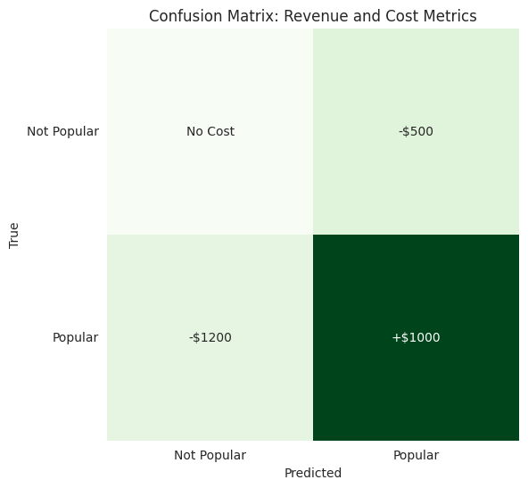
Revenue and Cost Metrics in Model Evaluation
Confusion Matrix Cost Structure:
- Revenue Generation:
- Correct popular predictions earn $1,000
- Successful identification crucial for profitability
- Cost Management:
- False popular predictions cost $500
- Missed popular songs cost $1,200
- Accurate non-popular predictions have no cost impact
Business Implications:
- Accuracy alone doesn't reflect financial performance
- Higher penalty for missing popular songs
- Strategic importance of reducing false negatives

Slide 25
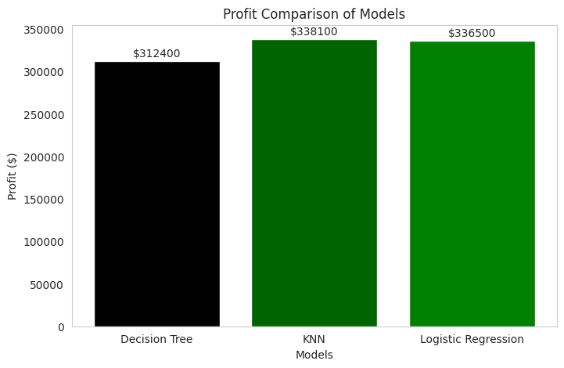
Profit-Based Model Selection Results
Model Profit Performance:
- Decision Tree: $312,400
- Lower profit due to high false negative rate
- KNN: $338,100
- Highest profit through balanced predictions
- Logistic Regression: $336,500
- Strong performance with consistent results
Profit Calculation Method:
Profit = (1000 × True Positives) - (500 × False Positives) - (1200 × False Negatives)
Key Finding: KNN achieves highest profit by minimizing costly false negatives while maintaining strong true positive rate

Slide 26
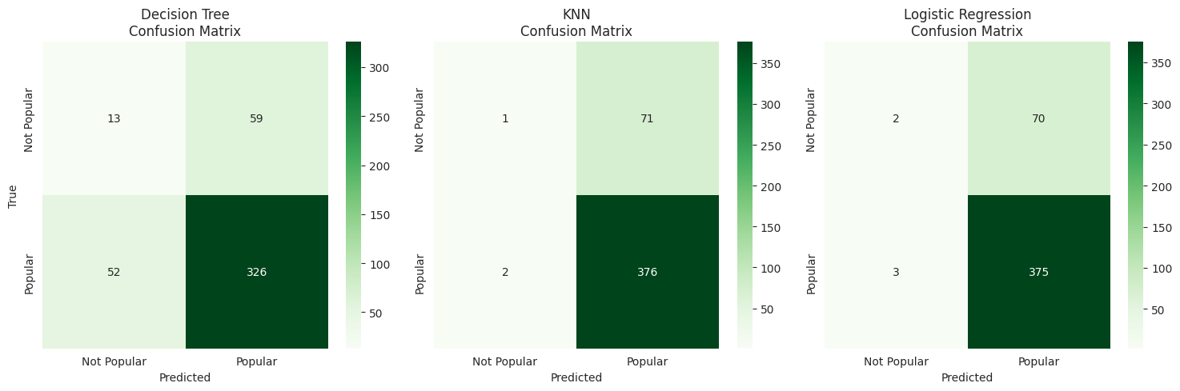
ACCURACY VS. PROFIT TRADE-OFFS
Model Selected in Q1 (Accuracy-Based):
KNN
Achieved the highest test accuracy (83.78%) and cross-validation accuracy (83.05%).
Key strength: High recall for identifying popular songs.
Model Selected in Q2 (Profit-Based):
KNN
Maximized the profit when evaluated on Spotify's cost/revenue structure.
Trade-Offs Observed:
Interpretability: KNN is less interpretable than Decision Trees but offers better performance.
Accuracy vs. Profit Consistency: KNN consistently performed well under both criteria, showing its robustness for Spotify's use case.
Key Takeaways:
KNN is a reliable model for Spotify, balancing prediction accuracy and financial profitability.
Both Q1 and Q2 validate KNN as the most suitable model for the recommendation system.

Slide 27

RECOMMENDATIONS FOR SPOTIFY
Strategic Implementation:
- Adopt KNN model for song recommendation system
- Focus on minimizing false negatives to maximize profit
- Regular model recalibration based on market dynamics
Model Enhancement:
- Fine-tune KNN parameters for optimal performance
- Implement feature engineering for improved accuracy
- Adjust thresholds based on cost-benefit analysis
Expected Benefits:
- Improved ROI on song promotion
- Enhanced user experience
- Better prediction of potential hits
- Reduced costs from prediction errors

Slide 28


Phase 3: Feature Insights and Clustering (Q3)
Analyzing Song Features & Success Patterns for Spotify
Analyzing aspects:
Relationship between song valence and success across different music clusters
Feature combinations driving song popularity
Purpose:
Enhance playlist recommendations through data-driven insights
Methodology:
Clustering and regression analysis of 1500 songs
Features Danceability and Energy as key clustering dimensions

Slide 29
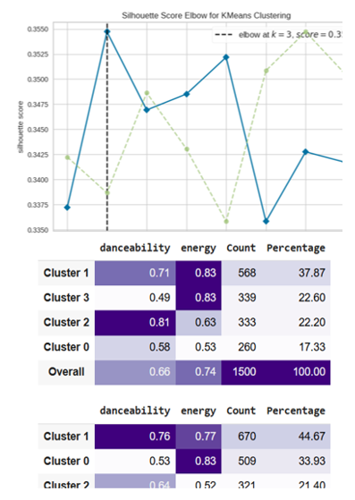
METHOD 1: K-MEANS CLUSTERING ANALYSIS
Key Insight: Silhouette score peaks at k=3, indicating optimal cluster separation
2. Balanced Cluster (21.40%):
• Danceability: 0.64 | Energy: 0.52
• 321 songs
• Profile: Moderate energy tracks for casual listening
• Strategy: Recommend for daily routine playlists
High Energy & Dance Cluster (44.67%):
• Danceability: 0.76 | Energy: 0.77
• 670 songs
• Profile: Upbeat, engaging tracks ideal for active playlists
• Strategy: Target workout and party playlist recommendations
3. High Energy/Low Dance Cluster (33.93%):
• Danceability: 0.53 | Energy: 0.83
• 509 songs
• Profile: Unique energy-dance combination suggesting niche appeal
• Strategy: Target specialized playlist recommendations

Slide 30
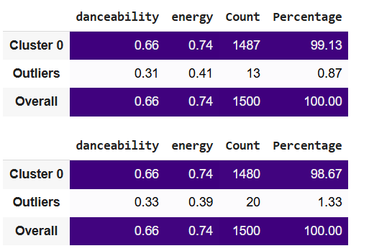
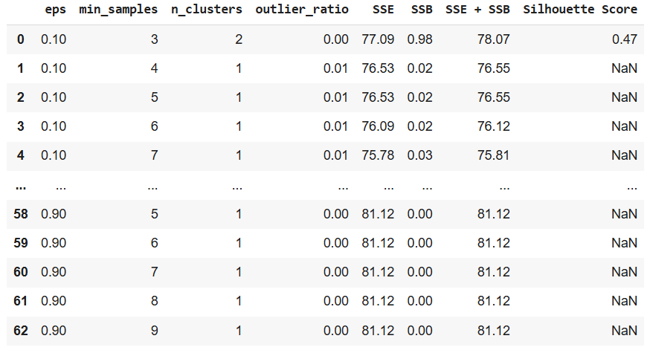
DBSCAN CLUSTERING RESULTS
Main Cluster (98.67%):
Average Danceability: 0.66 | Energy: 0.74
1,480 songs representing mainstream patterns
Recommendation Strategy: Base playlist algorithms on these typical patterns
Outlier Group (1.33%):
- Danceability: 0.33 | Energy: 0.39
20 songs with distinct characteristics
Key Finding: These tracks represent unique combinations that could serve specialized playlists
Insights for Playlist Optimization:
Use main cluster patterns for general recommendations
Leverage outliers for diversity in specialized playlists
Consider emotional valence when matching songs

Slide 31
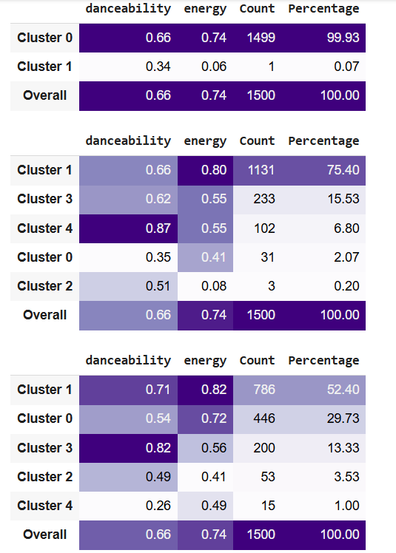
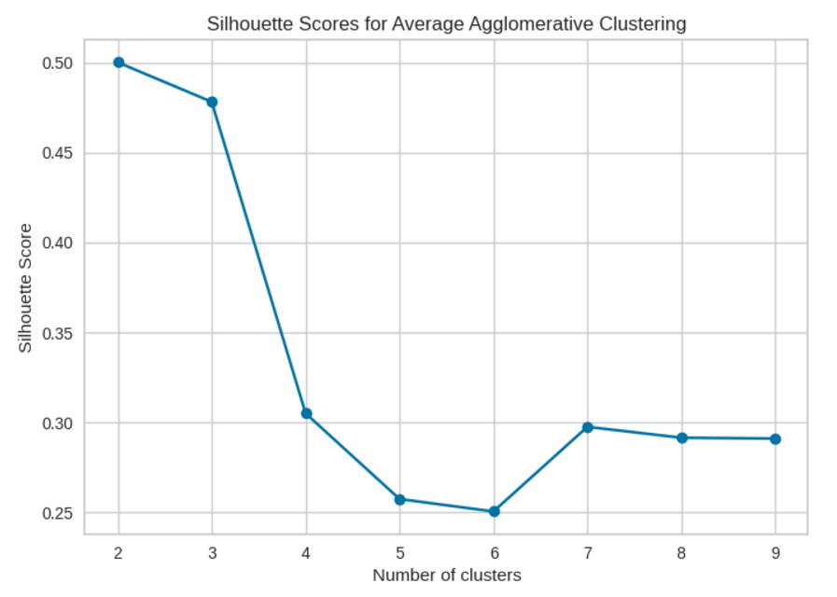
METHOD 3: AGGLOMERATIVE CLUSTERING
Hierarchical Clustering Analysis: Cluster Distribution:
Primary Cluster (75%):
• High energy (0.82) & danceability (0.71)
• Strong correlation with popularity
• Best for mainstream playlists
2. Secondary Clusters:
• Niche groups with distinct energy-dance combinations
• Varied emotional patterns (valence)
• Targeted for specific mood-based playlists
Silhouette Analysis: - Optimal clustering at 3-4 groups
- Clear separation of music styles
- Strong basis for playlist categorization

Slide 32
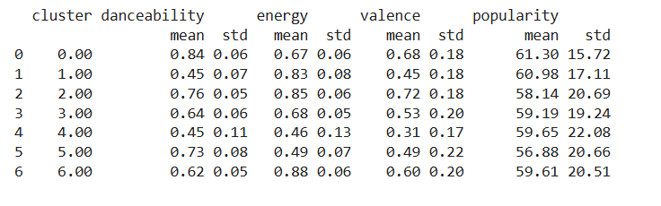
K-MEANS CLUSTERING RESULTS: ENERGY & DANCEABILITY PATTERNS
Popularity Patterns:
Higher popularity (mean ~61) in clusters with:
High energy (>0.80) + high danceability (>0.70)
Balanced valence (0.45-0.72)
Feature Combinations:
Most Popular Pattern:
Energy: 0.85 ± 0.06
Danceability: 0.76 ± 0.05
Valence: 0.72 ± 0.18
Recommendation Strategy:
Prioritize songs matching successful feature patterns
Consider emotional context (valence) in recommendations
Balance energy and danceability based on target audience

Slide 33
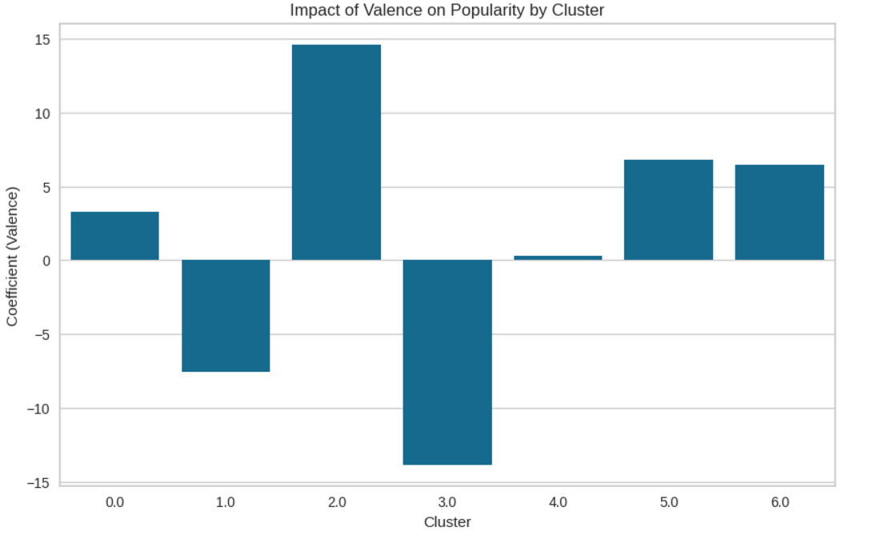
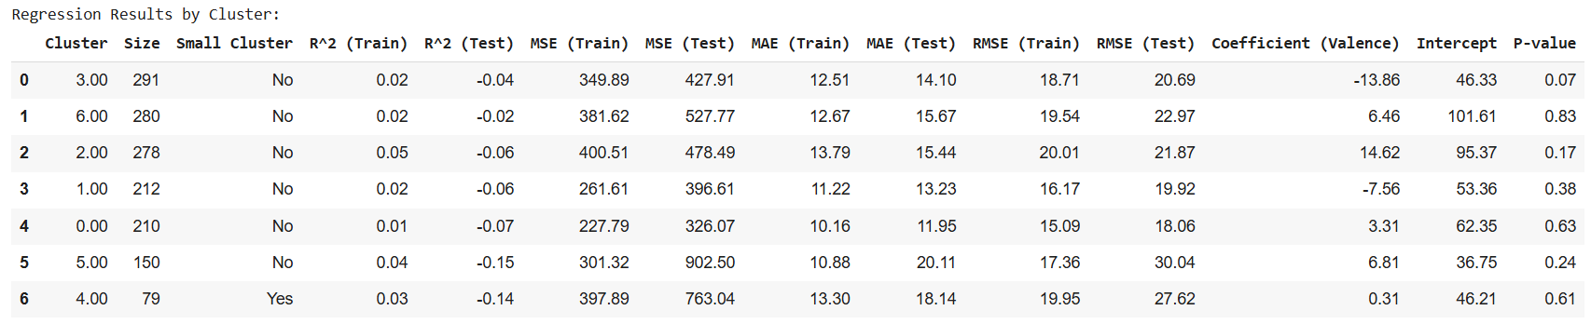
VALANCE IMPACT ANALYSIS

Slide 34
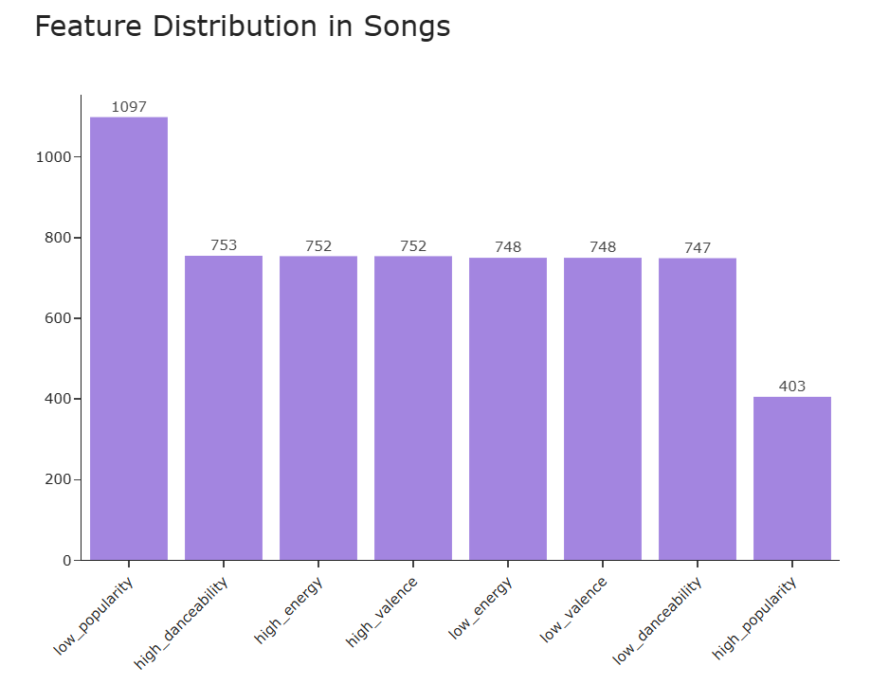
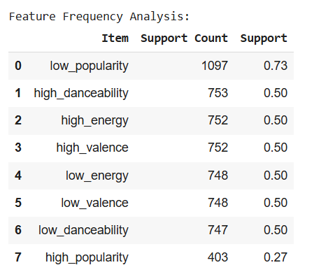
DISTRIBUTION ANALYSIS
Feature Frequency:
Low Popularity: Most common (1097 songs, 73%)
High Danceability/Energy/Valence: Balanced (≈750 songs, 50%)
High Popularity: Less frequent (403 songs, 27%)
Key Patterns:
Equal distribution of high/low feature values
Strong balance between energy and danceability
Clear popularity segmentation
Pattern Implications:
Feature combinations crucial for popularity
Balanced distribution suggests natural groupings
High popularity threshold identifies top performers

Slide 35
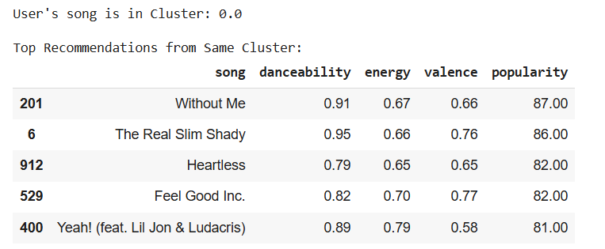
CLUSTER-BASED RECOMMENDATIONS
Sample Recommendations (Cluster 0.0):
Top Matched Songs:
"Without Me" (87% popularity)
High danceability (0.91)
Balanced energy (0.67)
"The Real Slim Shady" (86% popularity)
Very high danceability (0.95)
Moderate energy (0.66)
Common Features:
Danceability: 0.79-0.95
Energy: 0.65-0.79
Valence: 0.58-0.77
Popularity: 81-87%

Slide 36
ANALYSIS-BASED IMPLEMENTATION STRATEGY
Business Impact:
Enhanced prediction accuracy (83.78%)
Maximized profitability ($338,100 vs alternatives)
Improved user engagement through targeted recommendations
Model Selection & Application
• Implement KNN model for primary recommendation system
• Focus on minimizing costly prediction errors ($1,200 for missed hits)
• Regular model recalibration to maintain accuracy
Feature-Based Playlist Optimization
• High Energy & Dance Songs (44.7%): Target active/workout playlists
• Moderate Energy Songs (21.4%): Feature in daily listening
• Unique Combinations (1.3%): Reserve for specialized playlists
Key Performance Drivers
• Valence impact varies by cluster
most effective for high-energy songs
• Energy-danceability balance crucial for popularity
• Feature combinations more predictive than individual metrics

Slide 37
FINAL CONCLUSIONS & FUTURE DIRECTIONS
Immediate Implementation
• Deploy KNN model for main recommendation engine
• Structure playlists based on identified clusters
• Implement profit-based selection criteria
Enhancement Opportunities
• Incorporate real-time user feedback
• Expand feature analysis (lyrics, user context)
• Develop cluster-specific recommendation strategies
Expected Outcomes
• Increased user engagement and retention
• Optimized revenue through better hit prediction
• More personalized user experience
Long-Term Vision: Create a dynamic, self-improving system that balances user preferences, popularity prediction, and business metrics while maintaining recommendation quality and user satisfaction.

Slide 38
THANK YOU

